Slide 1

FACE-LIGHT
FACE–LIGHT: Fast AES CTR Mode Encryption for Low-end Microcontrollers
Kyung-ho Kim, Seung-ju Choi, Hyeok-dong Kwon, Zhe Liu, Hwa-jeong Seo
2019 ICISC
https://crypto.modoo.at

Slide 2
Overview
FACE–LIGHT: Fast AES CTR Mode Encryption for Low-end Microcontrollers
Overview
00
FACE-LIGHT
Improved implementation of a FACE (CHES 2018)
Improvements
Reduced the size of the Look Up Table
Removed the need to update the look up table

Slide 3
CONTENTS
01 02 03 04
Introduction
FACE
Our Work
Conclusion
- AES
- Side Channel Attack
- Masking
- Outline
- Structure
- FACE-LIGHT
- Extended-FACE
- Evaluation
- Contribution
- Future Work
2019 ICISC

Slide 4
FACE–LIGHT: Fast AES CTR Mode Encryption for Low-end Microcontrollers
01
Introduction
FACE-LIGHT

Slide 5
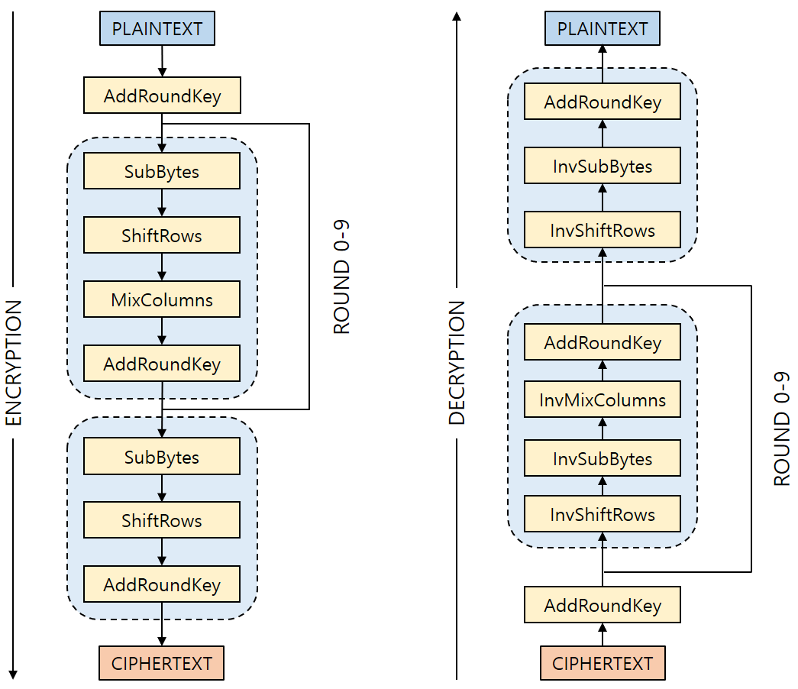
AES (Advanced Encryption Standard)
FACE–LIGHT: Fast AES CTR Mode Encryption for Low-end Microcontrollers
Introduction
01
World side block cipher standard
FIPS 197
ISO/IEC 18033-3
AES Modes
ECB, CBC, CFB, OFB, CTR
Fig 1. AES Structure

Slide 6
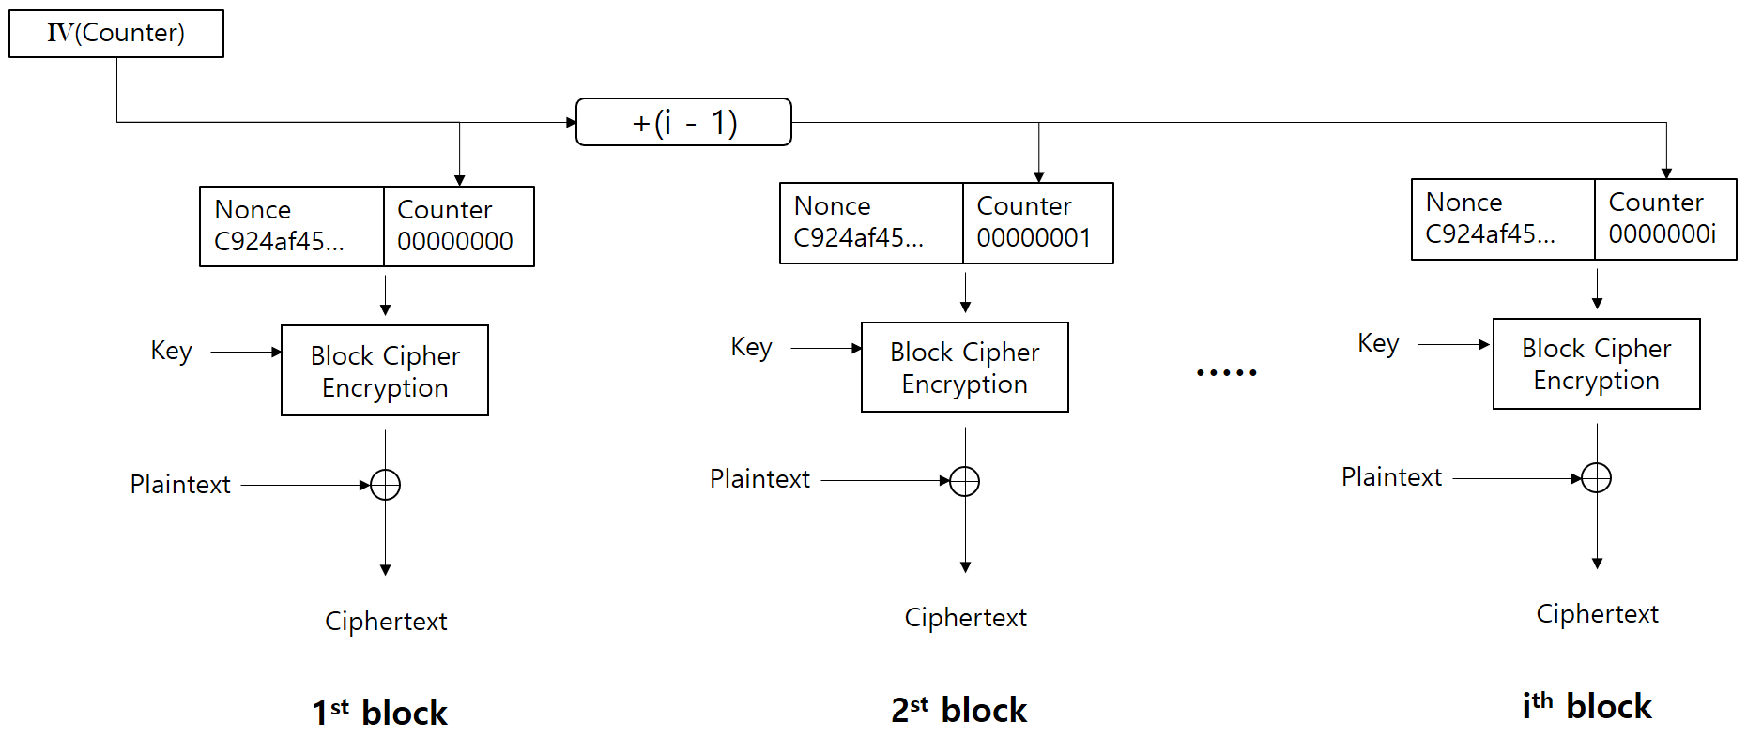
AES-CTR
FACE–LIGHT: Fast AES CTR Mode Encryption for Low-end Microcontrollers
Introduction
01
AES Counter Mode
Parallel Process
128bits IV(Initial Vector)
96bits Nonce
32bits Counter
Counter value increases by 1 on each block
Fig 2. AES-CTR Structure

Slide 7
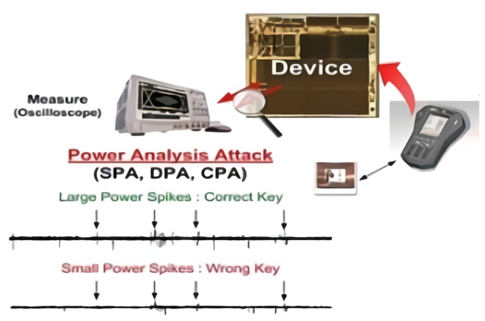
Side Channel Attack(SCA)
FACE–LIGHT: Fast AES CTR Mode Encryption for Low-end Microcontrollers
Introduction
01
Attack based on additional information during cipher operation
Power Analysis
SPA(Simple Power Analysis)
DPA(Differential Power Analysis)
CPA(Correlation Power Analysis)
Fig 3. Power Analysis Attack

Slide 8
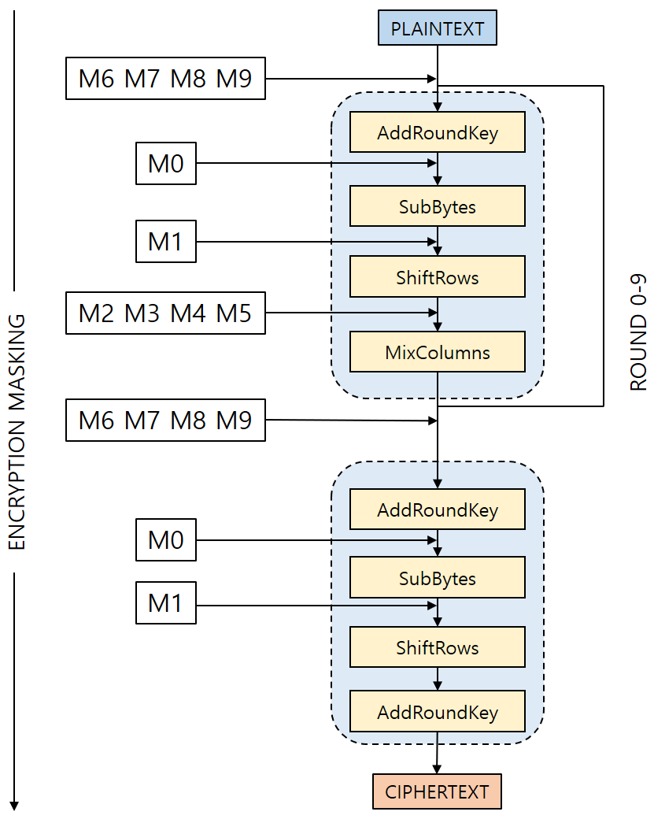

Masking
FACE–LIGHT: Fast AES CTR Mode Encryption for Low-end Microcontrollers
Introduction
01
SCA Countermeasure
Preventing power analysis
Implemented with reference to the published masking technique*
Optimized Implementation on 8bits Microcontroller
Fig 4. Masking Process
*C. Herbst, E. Oswald, and S. Mangard, “An aes smart card implementation resistant to power analysis attacks,” in ACNS, pp. 239–252, Springer, 2006.

Slide 9
FACE–LIGHT: Fast AES CTR Mode Encryption for Low-end Microcontrollers
02
FACE
FACE-LIGHT

Slide 10
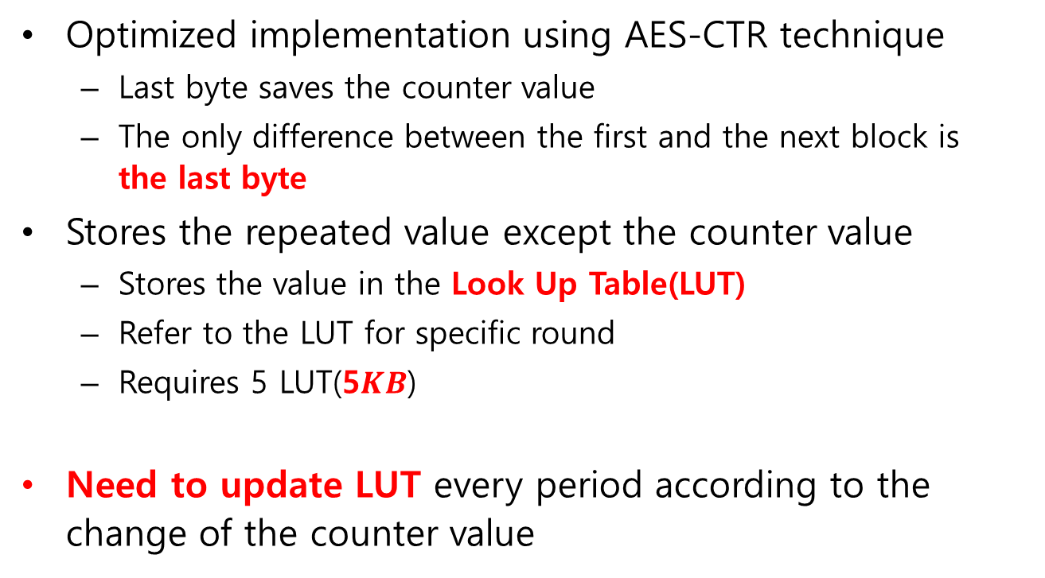
Outline
FACE–LIGHT: Fast AES CTR Mode Encryption for Low-end Microcontrollers
FACE
02
Optimized implementation using AES-CTR technique
Last byte saves the counter value
The only difference between the first and the next block is the last byte
Stores the repeated value except the counter value
Stores the value in the Look Up Table(LUT)
Refer to the LUT for specific round
Requires 5 LUT(5$KB$)
Need to update LUT every period according to the change of the counter value

Slide 11
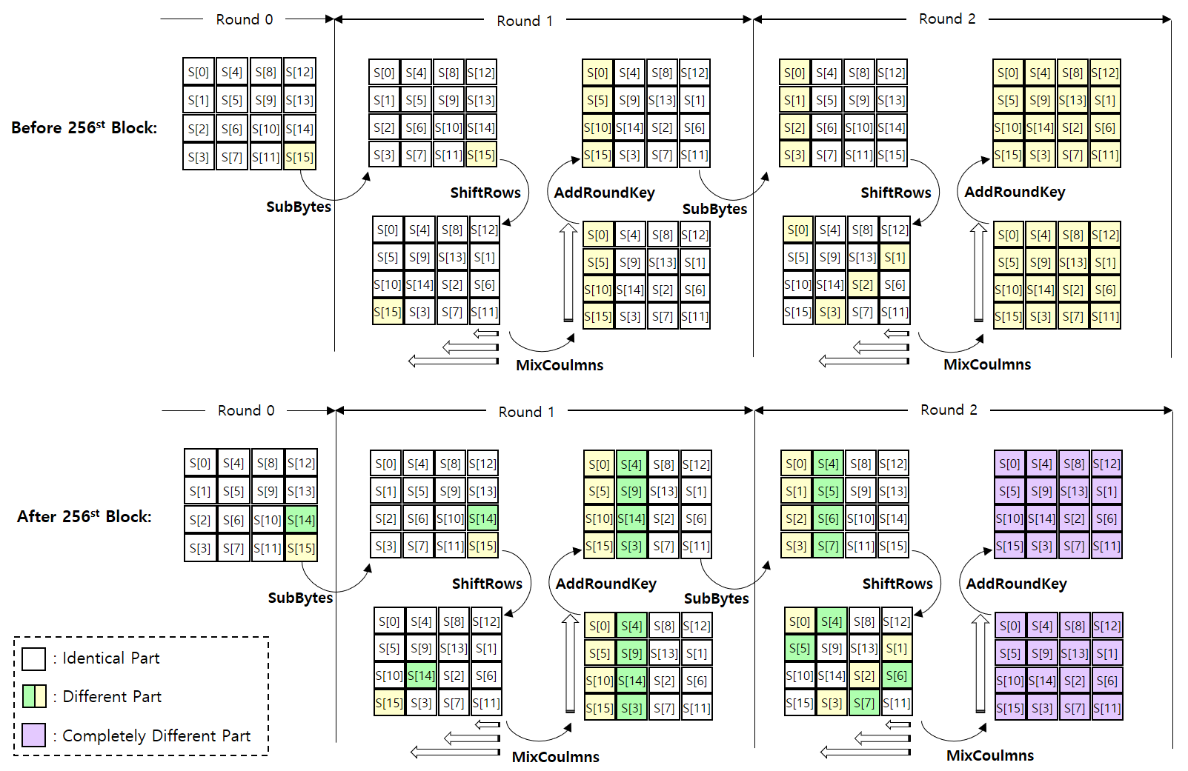
FACE–LIGHT: Fast AES CTR Mode Encryption for Low-end Microcontrollers
FACE
02
th
MixColumns
MixColumns
th
MixColumns
MixColumns

Slide 12
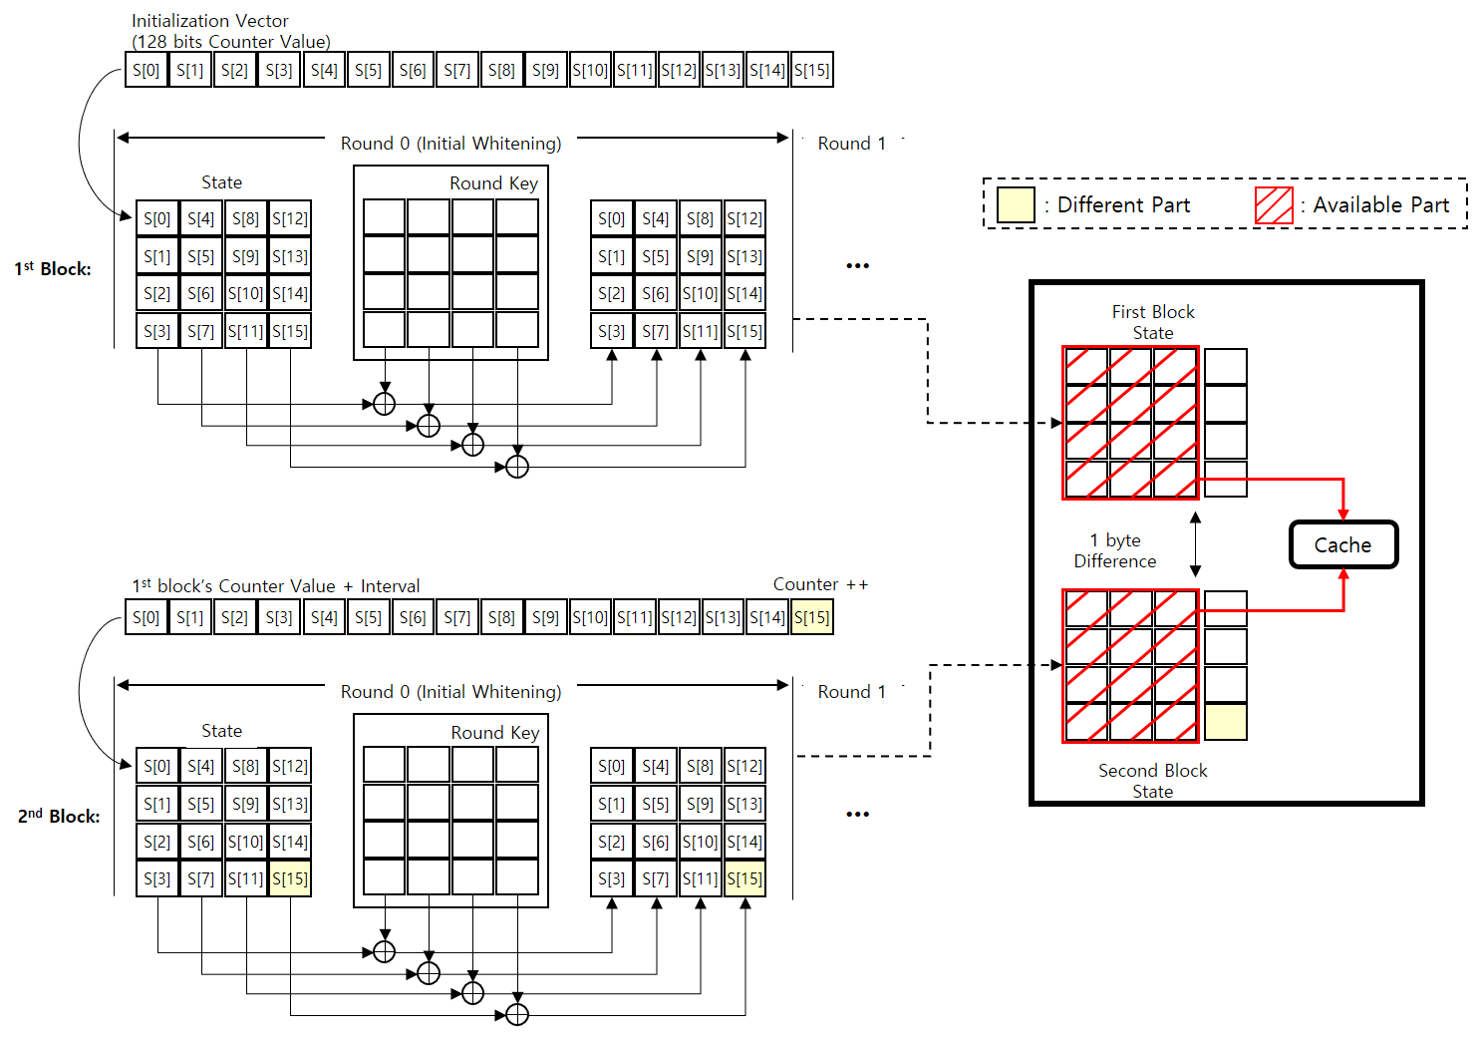
Structure (Round 0)
FACE–LIGHT: Fast AES CTR Mode Encryption for Low-end Microcontrollers
FACE
02
Utilize the change of last bytes of the data
The difference between the first block and the next block is 1byte
12 Bytes can be utilized after Round 0
S[12], S[13], S[14], S[15]
Table can be used (2³² – 1)times
No need for update

Slide 13
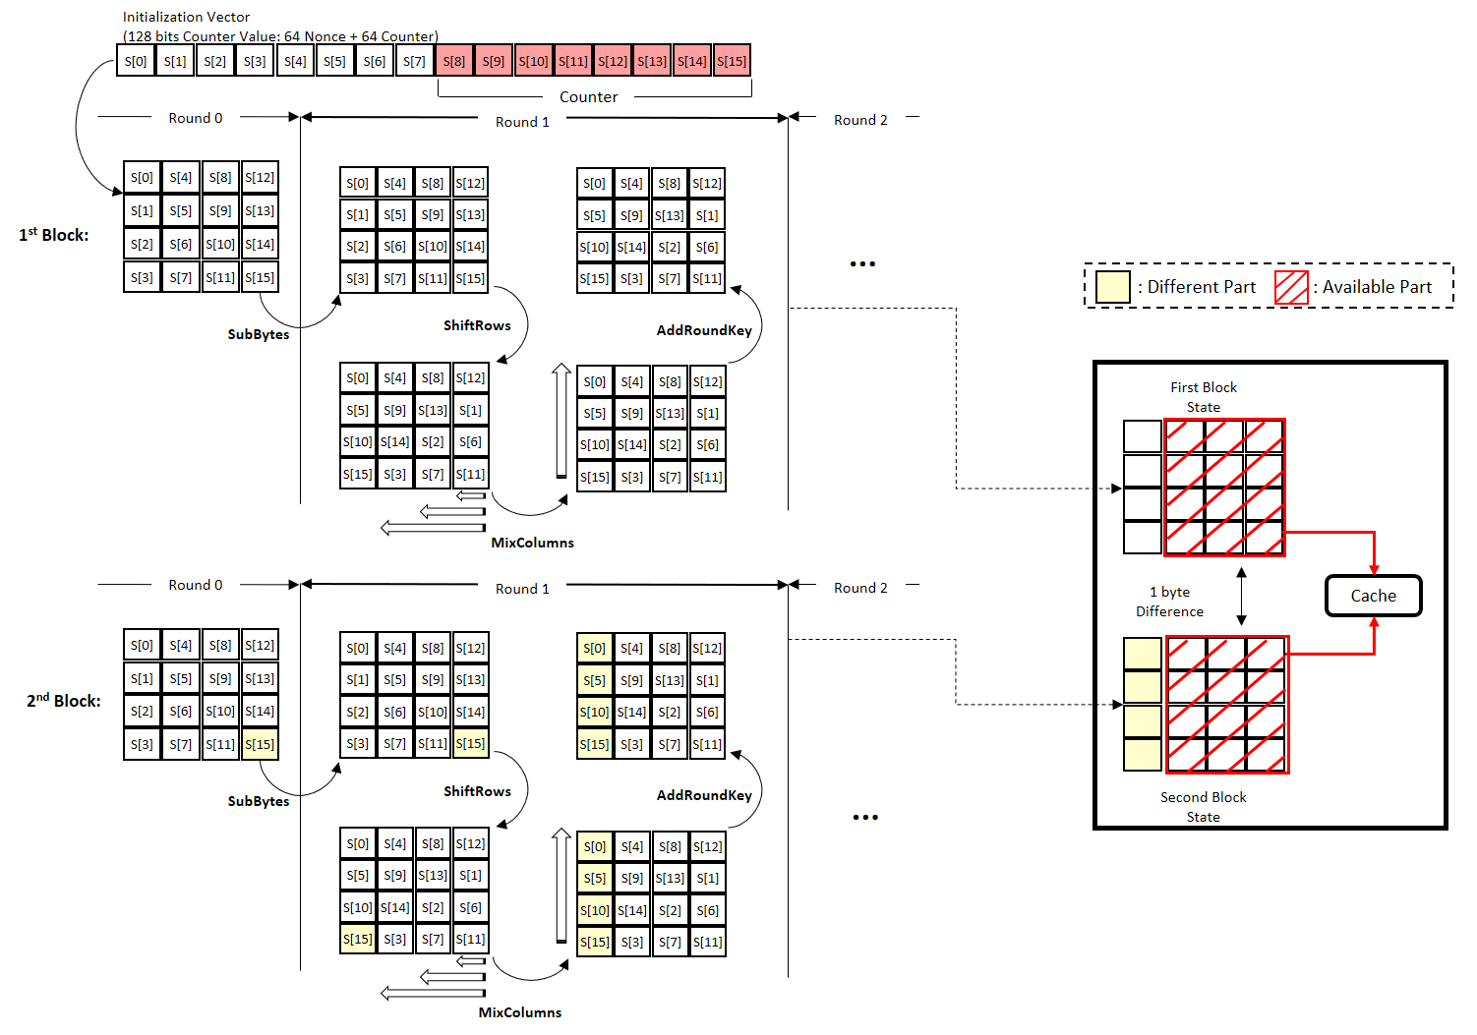
Structure (Round 1)
FACE–LIGHT: Fast AES CTR Mode Encryption for Low-end Microcontrollers
FACE
02
Last byte spreading
Spreads across two stages
ShiftRows
MixColumns
LUT generation available
Excpet first column
Table can be used (2⁸ – 1) times

Slide 14
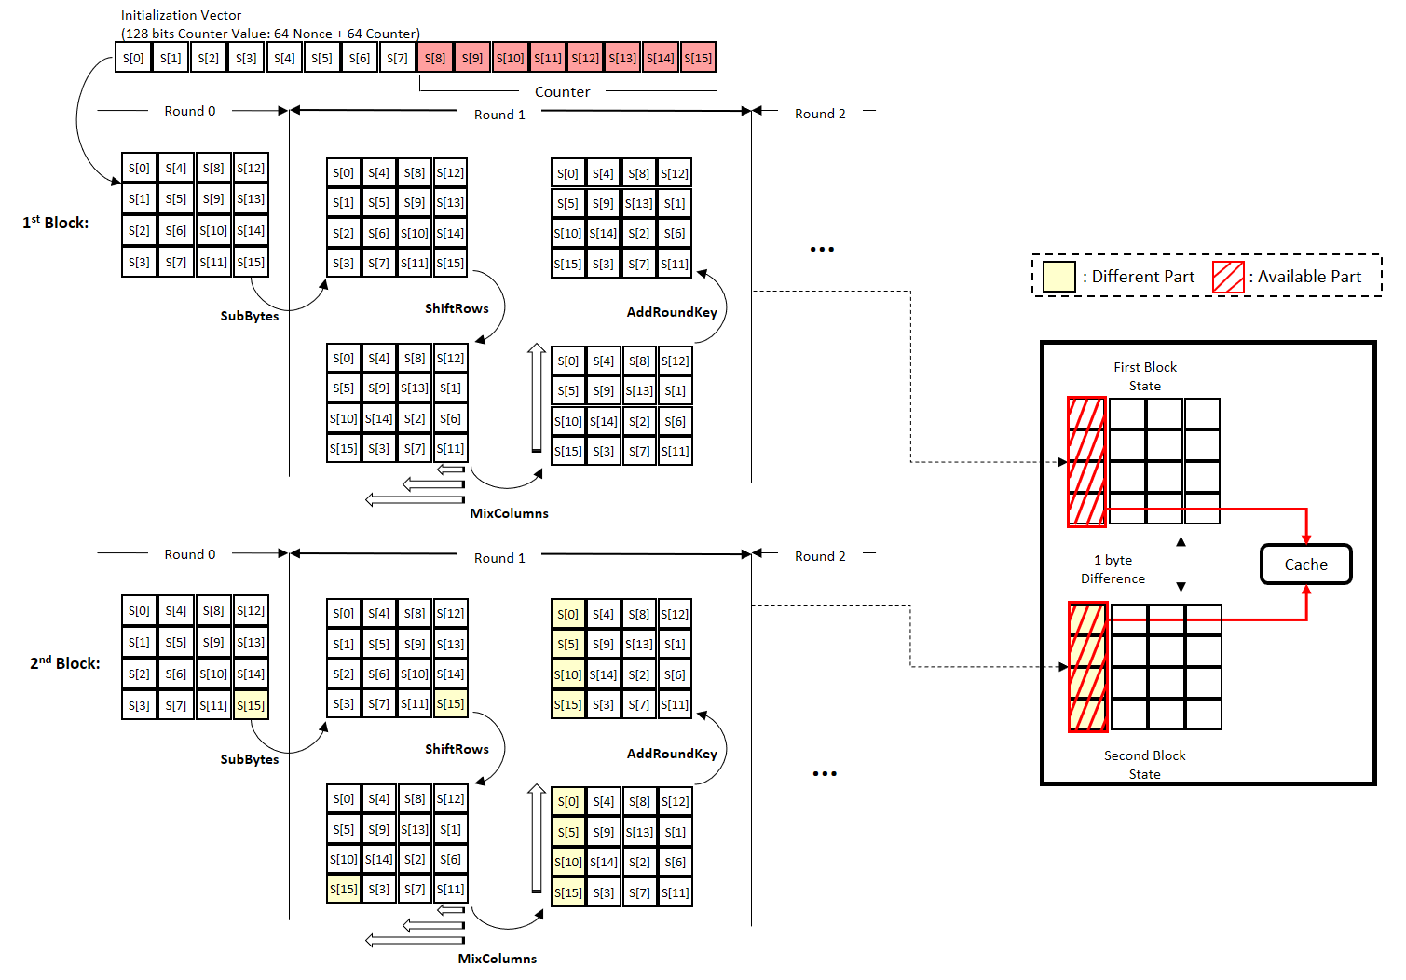
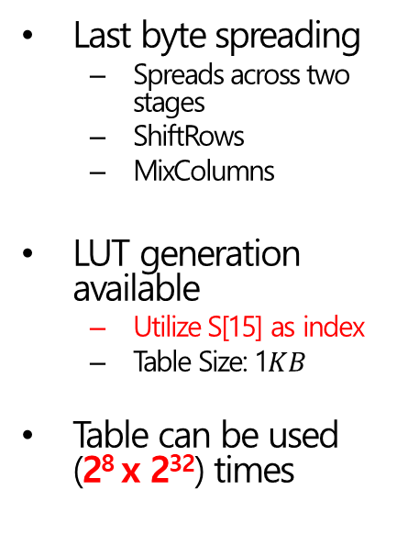
Structure (Round 1+)
FACE–LIGHT: Fast AES CTR Mode Encryption for Low-end Microcontrollers
FACE
02
Last byte spreading
Spreads across two stages
ShiftRows
MixColumns
LUT generation available
Utilize S[15] as index
Table Size: 1$KB$
Table can be used (2⁸ x 2³²) times

Slide 15
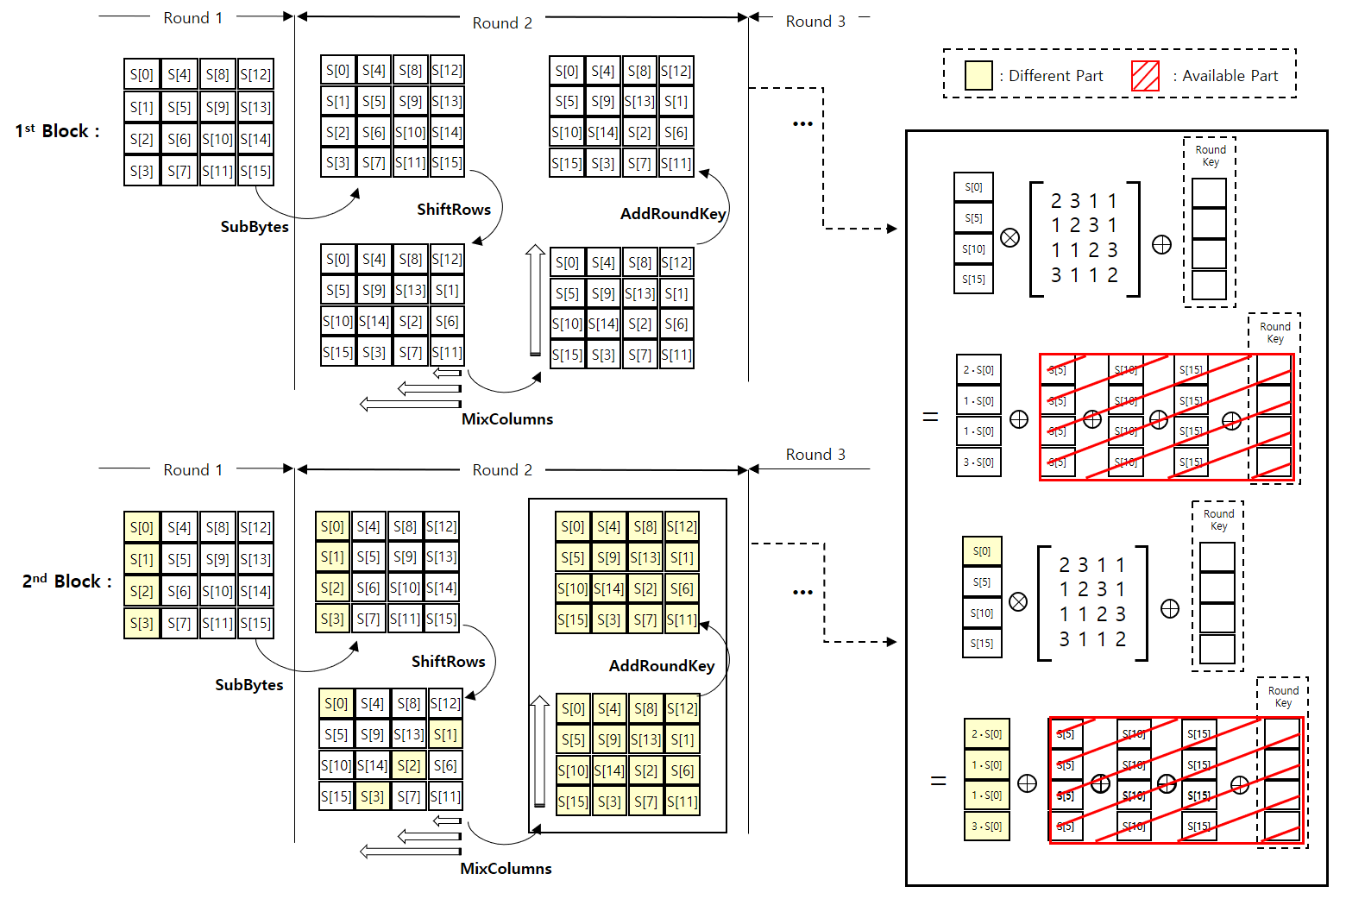
Structure (Round 2)
FACE–LIGHT: Fast AES CTR Mode Encryption for Low-end Microcontrollers
FACE
02
First column spreading
Spreads across two stages
ShiftRows
MixColumns
All values are affected after Round 2
LUT generation available
Intermediate value during MixColumns
Table can be used (2⁸ - 1) times

Slide 16
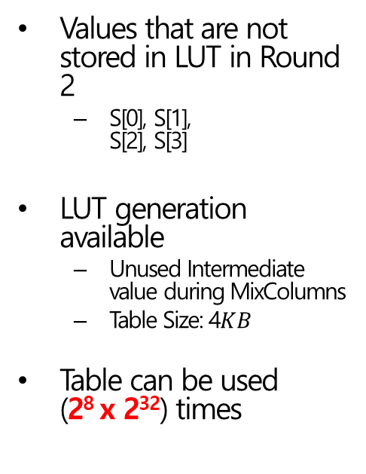
Structure (Round 2+)
FACE–LIGHT: Fast AES CTR Mode Encryption for Low-end Microcontrollers
FACE
02
Values that are not stored in LUT in Round 2
S[0], S[1], S[2], S[3]
LUT generation available
Unused Intermediate value during MixColumns
Table Size: 4$KB$
Table can be used (2⁸ x 2³²) times

Slide 17
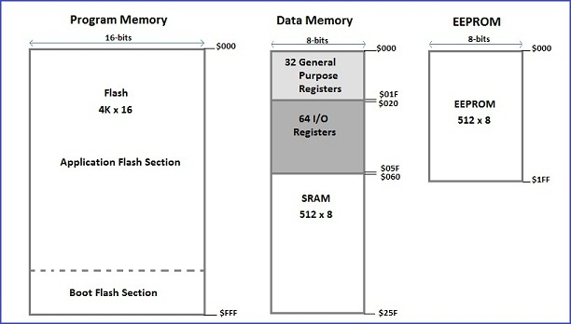

FACE–LIGHT: Fast AES CTR Mode Encryption for Low-end Microcontrollers
FACE
02
Limitation of FACE
Difficult to utilize on 8bits Microcontroller
LUT capacity issues
Requires minimum $5KB$ of memory
Requires updates of LUT at regular intervals
Fig 6. Arduino Uno Memory Structure

Slide 18
FACE–LIGHT: Fast AES CTR Mode Encryption for Low-end Microcontrollers
03
Our Work
FACE - LIGHT
FACE-LIGHT

Slide 19
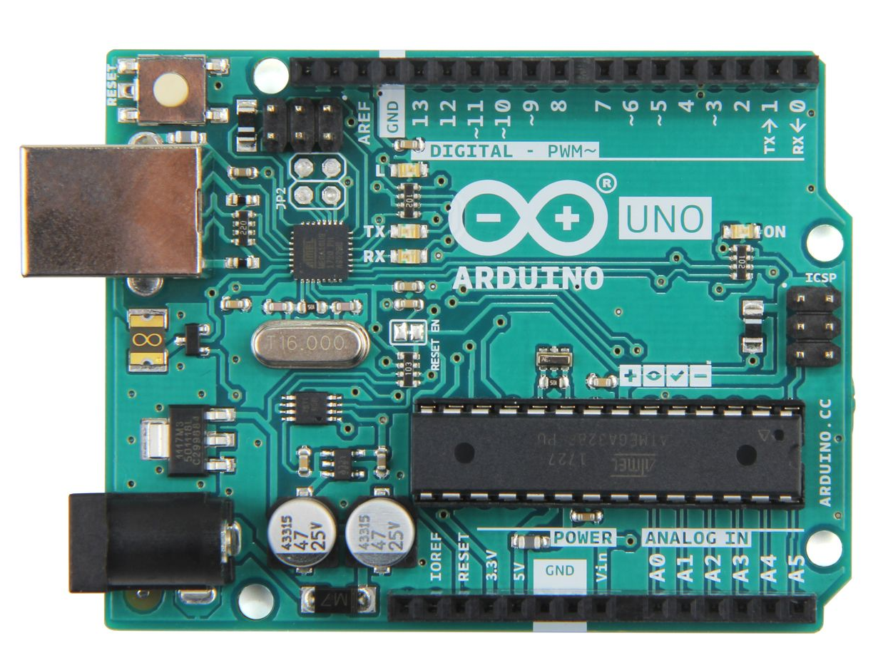
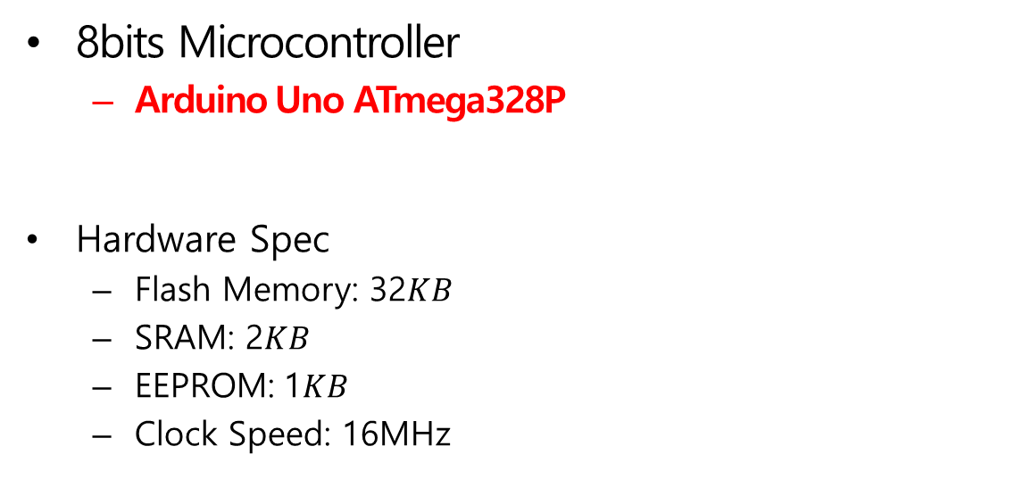
Target Board
FACE–LIGHT: Fast AES CTR Mode Encryption for Low-end Microcontrollers
Our Work
03
8bits Microcontroller
Arduino Uno ATmega328P
Hardware Spec
Flash Memory: 32$KB$
SRAM: 2$KB$
EEPROM: 1$KB$
Clock Speed: 16MHz
Fig 7. Arduino Uno

Slide 20
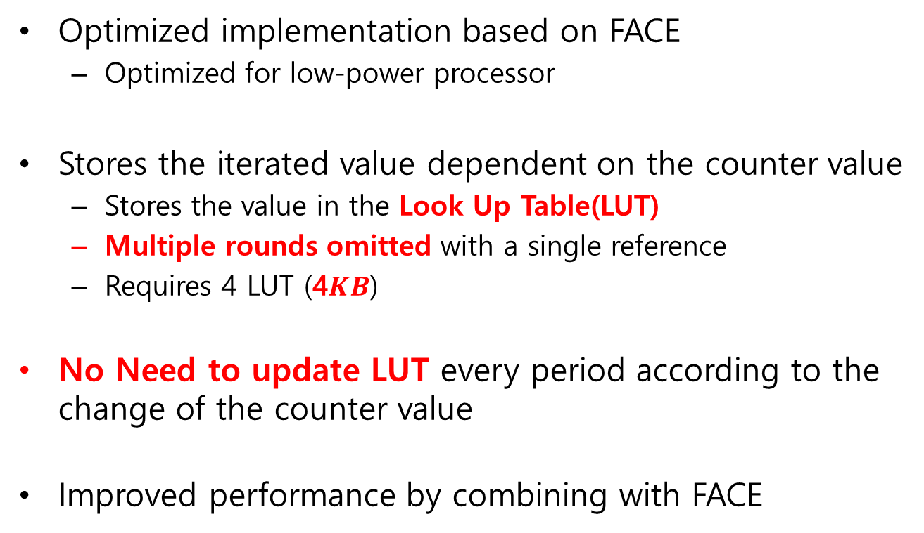
Overview
FACE–LIGHT: Fast AES CTR Mode Encryption for Low-end Microcontrollers
Our Work
03
Optimized implementation based on FACE
Optimized for low-power processor
Stores the iterated value dependent on the counter value
Stores the value in the Look Up Table(LUT)
Multiple rounds omitted with a single reference
Requires 4 LUT (4$KB$)
No Need to update LUT every period according to the change of the counter value
Improved performance by combining with FACE

Slide 21
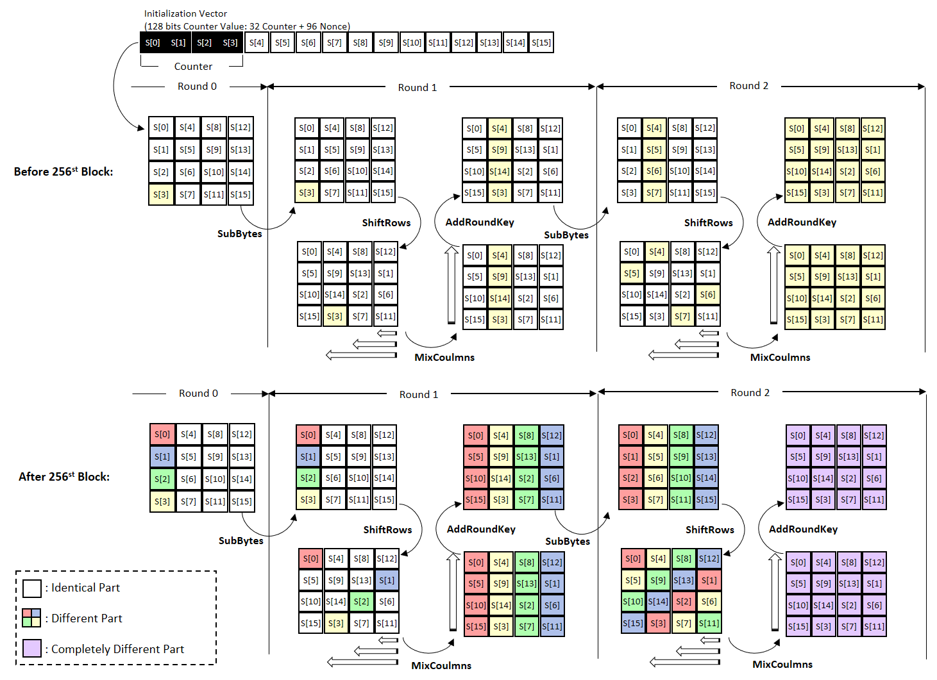
FACE–LIGHT: Fast AES CTR Mode Encryption for Low-end Microcontrollers
Our Work
03
th
MixColumns
MixColumns
th
MixColumns
MixColumns
Fig 8. Overview of FACE-LIGHT

Slide 22
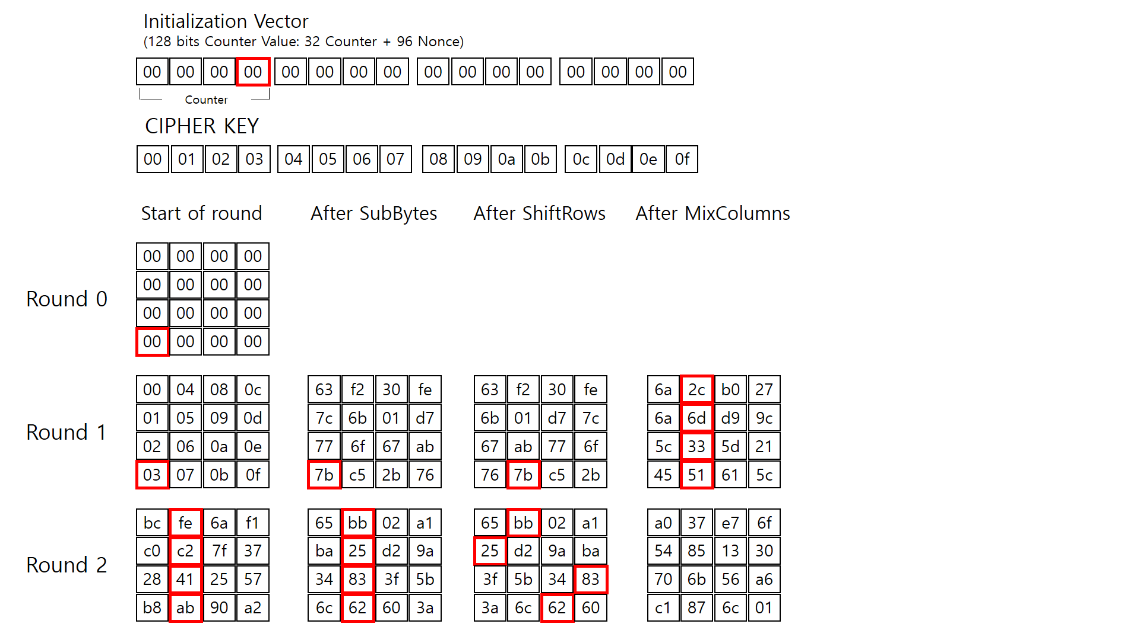
FACE–LIGHT: Fast AES CTR Mode Encryption for Low-end Microcontrollers
Our Work
03

Slide 23
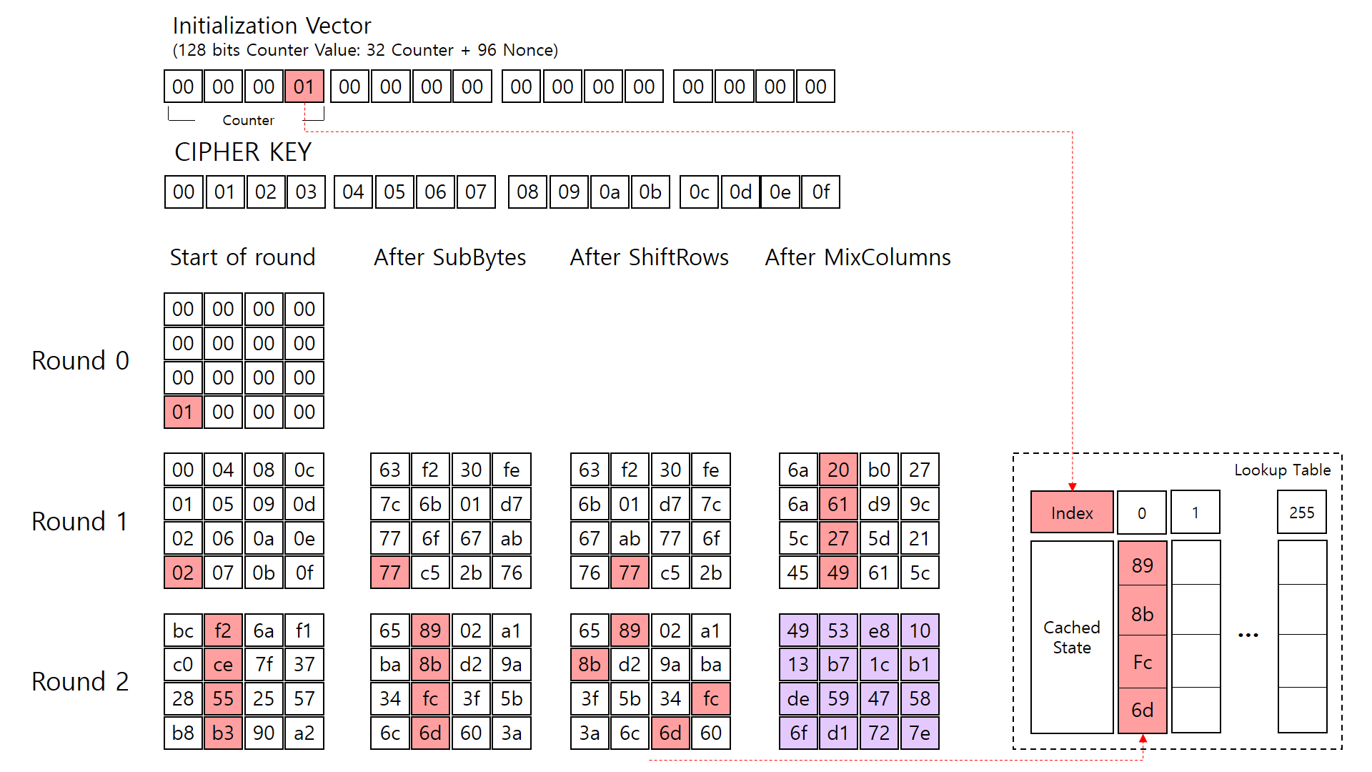
FACE–LIGHT: Fast AES CTR Mode Encryption for Low-end Microcontrollers
Our Work
03

Slide 24

FACE–LIGHT: Fast AES CTR Mode Encryption for Low-end Microcontrollers
Our Work
03

Slide 25
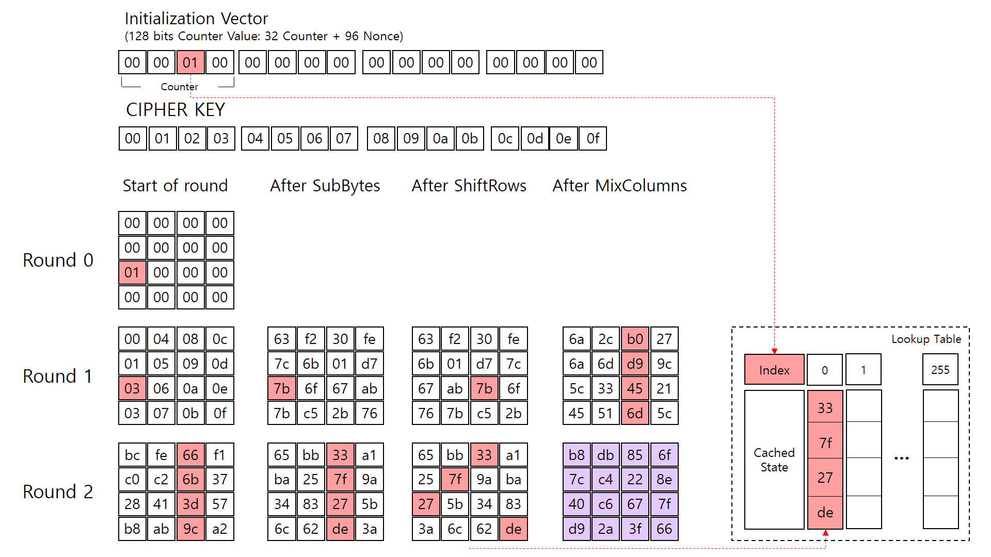
FACE–LIGHT: Fast AES CTR Mode Encryption for Low-end Microcontrollers
Our Work
03

Slide 26
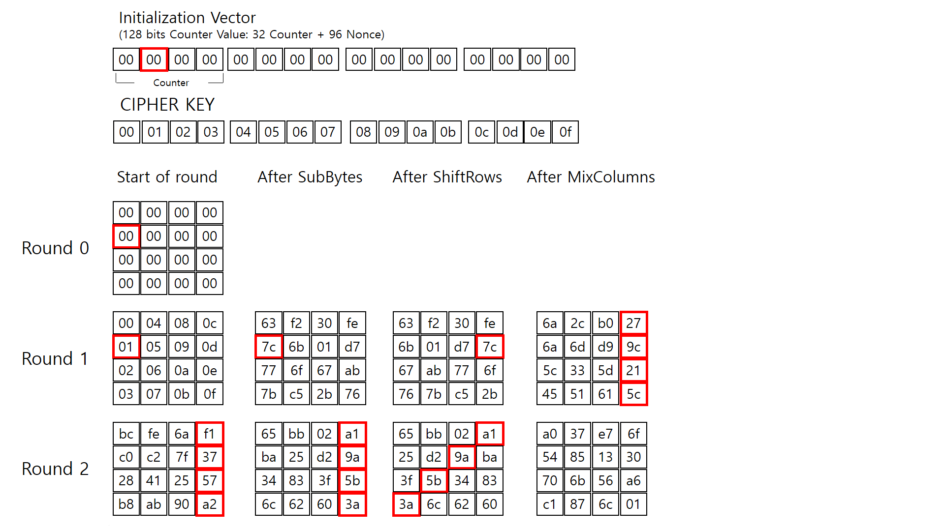
FACE–LIGHT: Fast AES CTR Mode Encryption for Low-end Microcontrollers
Our Work
03

Slide 27
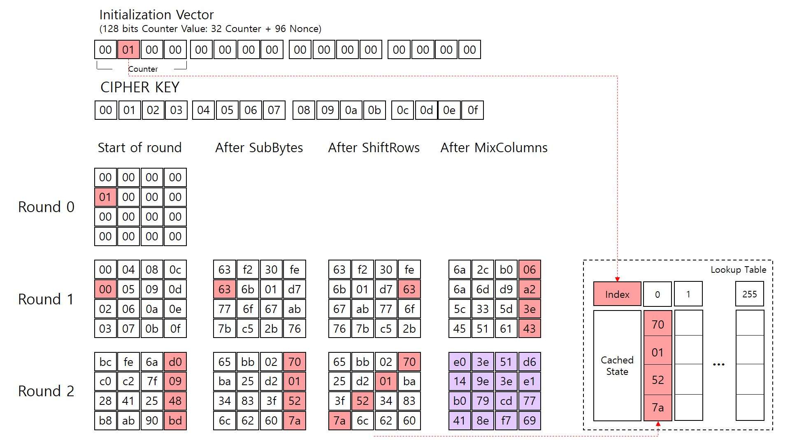
FACE–LIGHT: Fast AES CTR Mode Encryption for Low-end Microcontrollers
Our Work
03

Slide 28
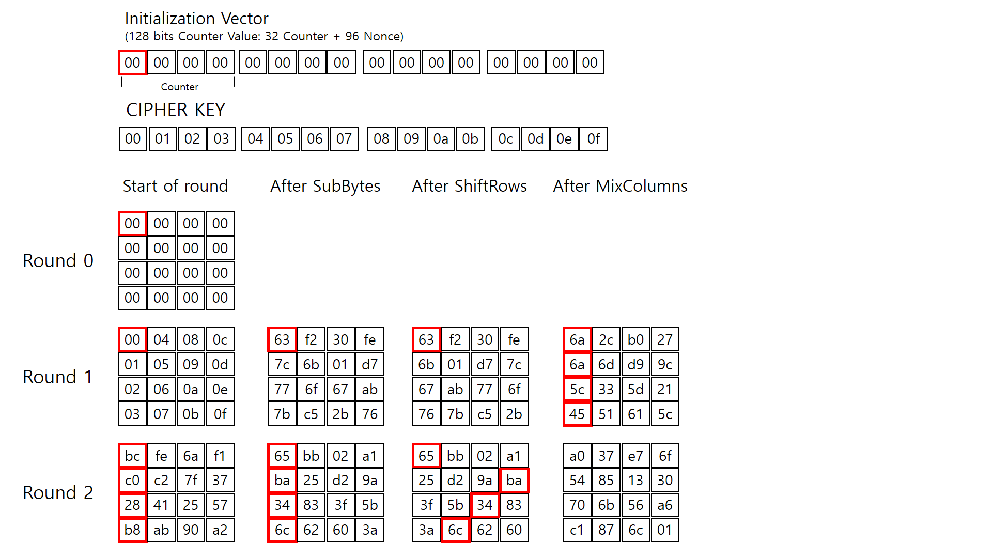
FACE–LIGHT: Fast AES CTR Mode Encryption for Low-end Microcontrollers
Our Work
03

Slide 29
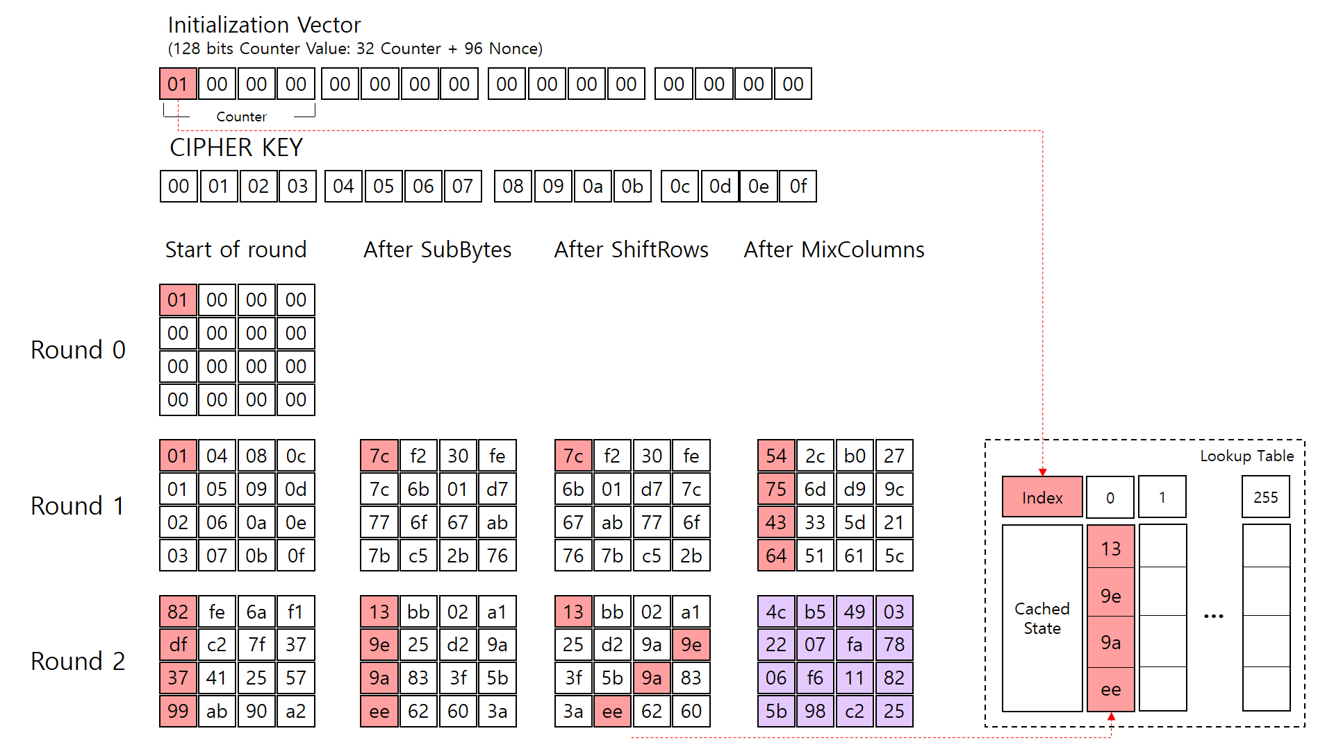
FACE–LIGHT: Fast AES CTR Mode Encryption for Low-end Microcontrollers
Our Work
03

Slide 30
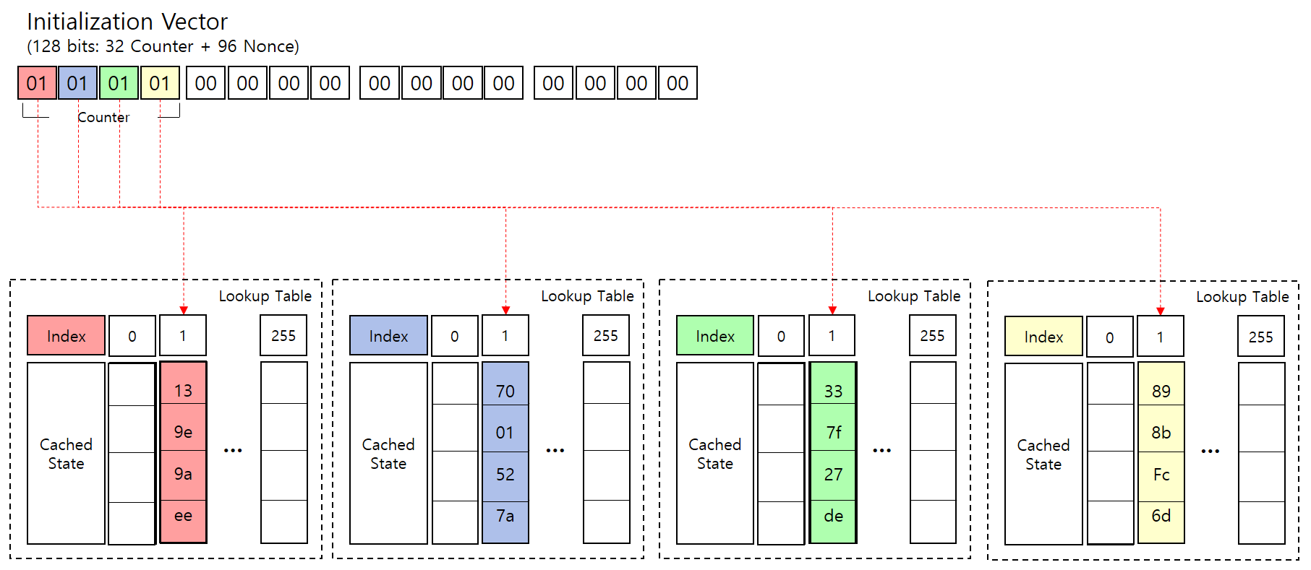

Look Up Table Structure
FACE–LIGHT: Fast AES CTR Mode Encryption for Low-end Microcontrollers
Our Work
03
Size of LUT: 4$KB$
Update not required
Fig 9. FACE-LIGHT Look Up Table

Slide 31
FACE–LIGHT: Fast AES CTR Mode Encryption for Low-end Microcontrollers
Our Work
03
Fig 8. Overview of FACE-LIGHT

Slide 32
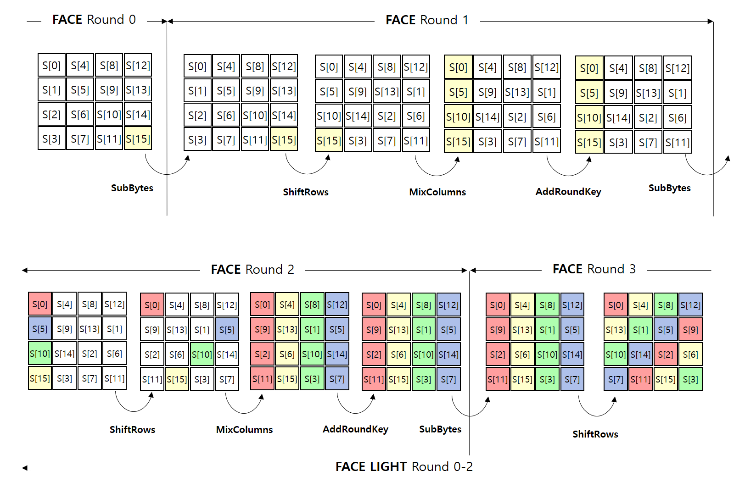
Extended FACE
FACE–LIGHT: Fast AES CTR Mode Encryption for Low-end Microcontrollers
Our Work
03
Extended FACE
Original FACE
FACE-Light
Operation reduction
Subbytes
AddRoundKey

Slide 33
FACE–LIGHT: Fast AES CTR Mode Encryption for Low-end Microcontrollers
Our Work
03
FACE
FACE-LIGHT
MixColumns
MixColumns
Round 0
Round 1
Round 2
S[0]
S[4]
S[8]
S[12]
S[0]
S[4]
S[8]
S[12]
S[0]
S[4]
S[8]
S[12]
S[0]
S[4]
S[8]
S[12]
S[5]
S[9]
S[13]
S[1]
S[9]
S[13]
S[1]
S[5]
S[9]
S[13]
S[1]
S[5]
S[9]
S[13]
S[1]
S[5]
S[10]
S[14]
S[2]
S[6]
S[2]
S[6]
S[10]
S[14]
S[2]
S[6]
S[10]
S[14]
S[2]
S[6]
S[10]
S[14]
S[15]
S[3]
S[7]
S[11]
S[11]
S[15]
S[3]
S[7]
S[11]
S[15]
S[3]
S[7]
S[11]
S[15]
S[3]
S[7]
ShiftRows
AddRoundKey
ShiftRows
…
SubBytes
S[0]
S[4]
S[8]
S[12]
S[0]
S[4]
S[8]
S[12]
SubBytes
S[0]
S[4]
S[8]
S[12]
S[9]
S[13]
S[1]
S[5]
S[9]
S[13]
S[1]
S[5]
S[13]
S[1]
S[5]
S[9]
S[2]
S[6]
S[10]
S[14]
S[2]
S[6]
S[10]
S[14]
S[10]
S[14]
S[2]
S[6]
S[11]
S[15]
S[3]
S[7]
S[11]
S[15]
S[3]
S[7]
S[7]
S[11]
S[15]
S[3]
MixColumns

Slide 34
FACE–LIGHT: Fast AES CTR Mode Encryption for Low-end Microcontrollers
Our Work
03
FACE
FACE-LIGHT
MixColumns
MixColumns
Round 0
Round 1
Round 2
S[0]
S[4]
S[8]
S[12]
S[0]
S[4]
S[8]
S[12]
S[0]
S[4]
S[8]
S[12]
S[0]
S[4]
S[8]
S[12]
S[5]
S[9]
S[13]
S[1]
S[9]
S[13]
S[1]
S[5]
S[9]
S[13]
S[1]
S[5]
S[9]
S[13]
S[1]
S[5]
S[10]
S[14]
S[2]
S[6]
S[2]
S[6]
S[10]
S[14]
S[2]
S[6]
S[10]
S[14]
S[2]
S[6]
S[10]
S[14]
S[15]
S[3]
S[7]
S[11]
S[11]
S[15]
S[3]
S[7]
S[11]
S[15]
S[3]
S[7]
S[11]
S[15]
S[3]
S[7]
ShiftRows
AddRoundKey
ShiftRows
…
SubBytes
S[0]
S[4]
S[8]
S[12]
S[0]
S[4]
S[8]
S[12]
SubBytes
S[0]
S[4]
S[8]
S[12]
S[9]
S[13]
S[1]
S[5]
S[9]
S[13]
S[1]
S[5]
S[13]
S[1]
S[5]
S[9]
S[2]
S[6]
S[10]
S[14]
S[2]
S[6]
S[10]
S[14]
S[10]
S[14]
S[2]
S[6]
S[11]
S[15]
S[3]
S[7]
S[11]
S[15]
S[3]
S[7]
S[7]
S[11]
S[15]
S[3]
MixColumns

Slide 35
FACE–LIGHT: Fast AES CTR Mode Encryption for Low-end Microcontrollers
Our Work
03
Extended FACE
MixColumns
MixColumns
Round 2
Round 3
S[0]
S[4]
S[8]
S[12]
S[0]
S[4]
S[8]
S[12]
S[0]
S[4]
S[8]
S[12]
S[0]
S[4]
S[8]
S[12]
S[5]
S[9]
S[13]
S[1]
S[9]
S[13]
S[1]
S[5]
S[9]
S[13]
S[1]
S[5]
S[9]
S[13]
S[1]
S[5]
S[10]
S[14]
S[2]
S[6]
S[2]
S[6]
S[10]
S[14]
S[2]
S[6]
S[10]
S[14]
S[2]
S[6]
S[10]
S[14]
S[15]
S[3]
S[7]
S[11]
S[11]
S[15]
S[3]
S[7]
S[11]
S[15]
S[3]
S[7]
S[11]
S[15]
S[3]
S[7]
ShiftRows
AddRoundKey
ShiftRows
…
SubBytes
S[0]
S[4]
S[8]
S[12]
S[0]
S[4]
S[8]
S[12]
SubBytes
S[0]
S[4]
S[8]
S[12]
S[9]
S[13]
S[1]
S[5]
S[9]
S[13]
S[1]
S[5]
S[13]
S[1]
S[5]
S[9]
S[2]
S[6]
S[10]
S[14]
S[2]
S[6]
S[10]
S[14]
S[10]
S[14]
S[2]
S[6]
S[11]
S[15]
S[3]
S[7]
S[11]
S[15]
S[3]
S[7]
S[7]
S[11]
S[15]
S[3]
MixColumns

Slide 36
Evaluation (Calculating Speed)
FACE–LIGHT: Fast AES CTR Mode Encryption for Low-end Microcontrollers
Our Work
03
22% performance improvement over standard AES
No additional LUT update time required
Unit: Clock Cycles
Security Level | Dinu et al. * | Otte et al. ** | FACE-Light (Our Work) | Ex-FACE (Our Work)
AES-128 | 2,835 | 2,507 | 2,218 | 1,967
AES-192 | N/A | 2,991 | 2,702 | 2,449
AES-256 | N/A | 3,473 | 3,184 | 2,931
Table 1. Comparison of calculating speed
* D. Dinu, A. Biryukov,“FELICS–fair evaluation of lightweight cryptographic systems,” inNIST, 2015.
** D. Otteet al., “AVR-crypto-lib,”Online: http://www. das–labor. org/wiki/AVR–Crypto–Lib/en, 2009.

Slide 37
Evaluation (vs FACE)
FACE–LIGHT: Fast AES CTR Mode Encryption for Low-end Microcontrollers
Our Work
03
Optimized for FACE-LIGHT 8bits Microcontroller
Support Constant Timing(No need to LUT update)
8bits low-power processor available without restrictions
 | FACE | FACE-LIGHT (Our Work)
Table Update | O | X
Constant Timing | Not Support | Support
Target Processor | 32-bits or above | 8-bits or above
Expandable Round | Round 2 | Round 3
Table 2. Comparison with original FACE

Slide 38
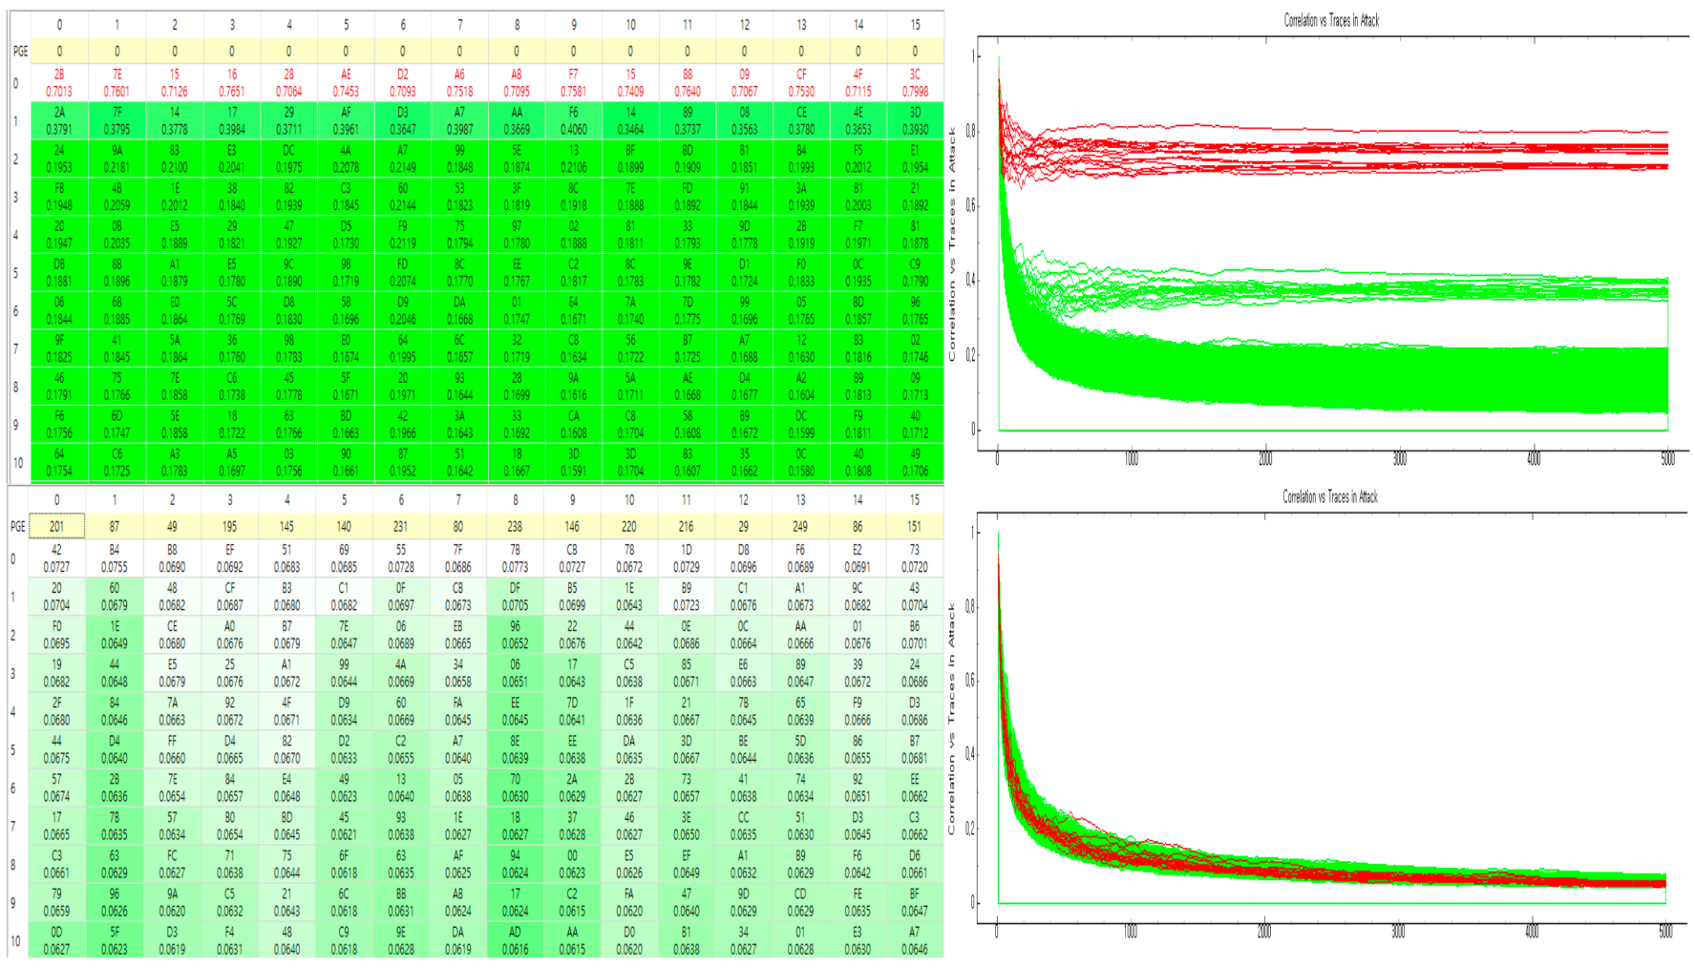
Evaluation (Side Channel Attack Resistance)
FACE–LIGHT: Fast AES CTR Mode Encryption for Low-end Microcontrollers
Our Work
03
Resistant to power analysis attacks (CPA, DPA)
Fig 10. Graph of Power Analysis

Slide 39
Evaluation (vs LEA)
FACE–LIGHT: Fast AES CTR Mode Encryption for Low-end Microcontrollers
Our Work
03
Better performance compared to Masked LEA using ARX operation
Improved performance over previous Masked AES
FACE-LIGHT, software optimization
Unit: Clock Cycles
LEA-128 * | Masked LEA-128 ** | Masked AES-128 (Previous Work)*** | Masked FACE-128 (Our Work)
2,688 | 36,589 | 25,970 | 6,219
Table 3. Comparison with LEA and Previous Work
* H. Seo, I. Jeong, J. Lee, and W. Kim, “Compact implementations of ARX-based block ciphers on IoT processors,” ACM TECS, 2018.
** E. Park, S. Oh, and J. Ha, “Masking-based block cipher LEA resistant to side channel attacks,” KIISC, 2017.
*** K. H. Kim, H. J. Seo, “Implementation of Optimized 1st-Order Masking AES Algorithm Against Side-Channel-analysis,” KIPS, 2019.

Slide 40
FACE–LIGHT: Fast AES CTR Mode Encryption for Low-end Microcontrollers
04
Conclusion
FACE-LIGHT

Slide 41
Contribution
FACE–LIGHT: Fast AES CTR Mode Encryption for Low-end Microcontrollers
Conclusion
04
Effective optimization of AES-CTR on low-power processor
Clock Cycles optimization
More Rounds are expandable than FACE
Difficult in predicting attack points(Timing being constant)
Masking operation to counter a side channel attack
Lightweight AES

Slide 42
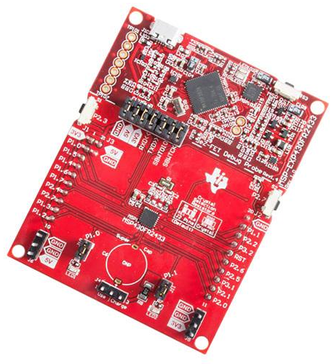
Future Work
FACE–LIGHT: Fast AES CTR Mode Encryption for Low-end Microcontrollers
Conclusion
04
Optimization on various platforms
16bits MSP … ETC
Optimize other domestic cryptography using our proposal
Pre-calculation of LUT
Side channel attack resistant
Software optimization
Apply proposed methods to AES modes
AES GCM
Fig 11. MSP430FR2433 LaunchPad kit

Slide 43


THANK
YOU
pgm.kkh@gmail.com
https://crypto.modoo.at

